Slide 1
Mission 0
Marketing Associates New Zealand

Slide 2

Project Brief
Mission 0 - Goal:
The project’s goal was to create a single-page application with a mobile responsive layout for the Marketing Association New Zealand's homepage.

Slide 3
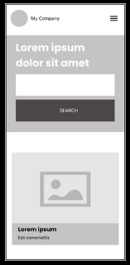
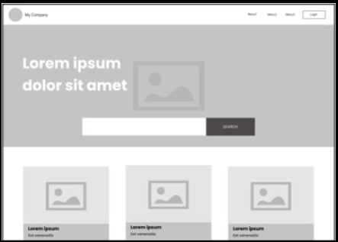
Project Brief
Wireframe Provided by the Client:
A wireframe was provided by the client to serve as a guide for the layout and structure of the homepage. This wireframe outlined the basic placement of elements such as the header, main content sections, and footer.

Slide 4
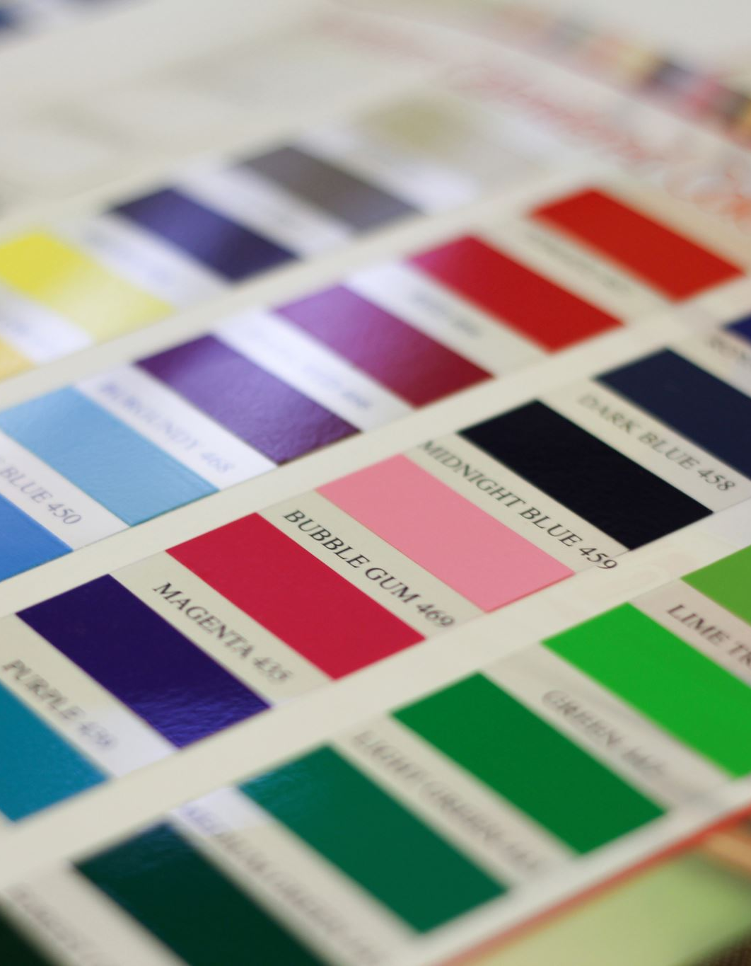
Project Brief
Search Functionality Not Required:
It was specified that the search functionality was not necessary for this prototype, allowing the focus to be on the layout and design elements.
Color Palette and Images:
The project did not specify a particular color palette or set of images, giving the flexibility to choose colors and visuals that would enhance the design and user experience. The selections made aimed to create a cohesive and engaging appearance that aligns with modern web design standards.

Slide 5



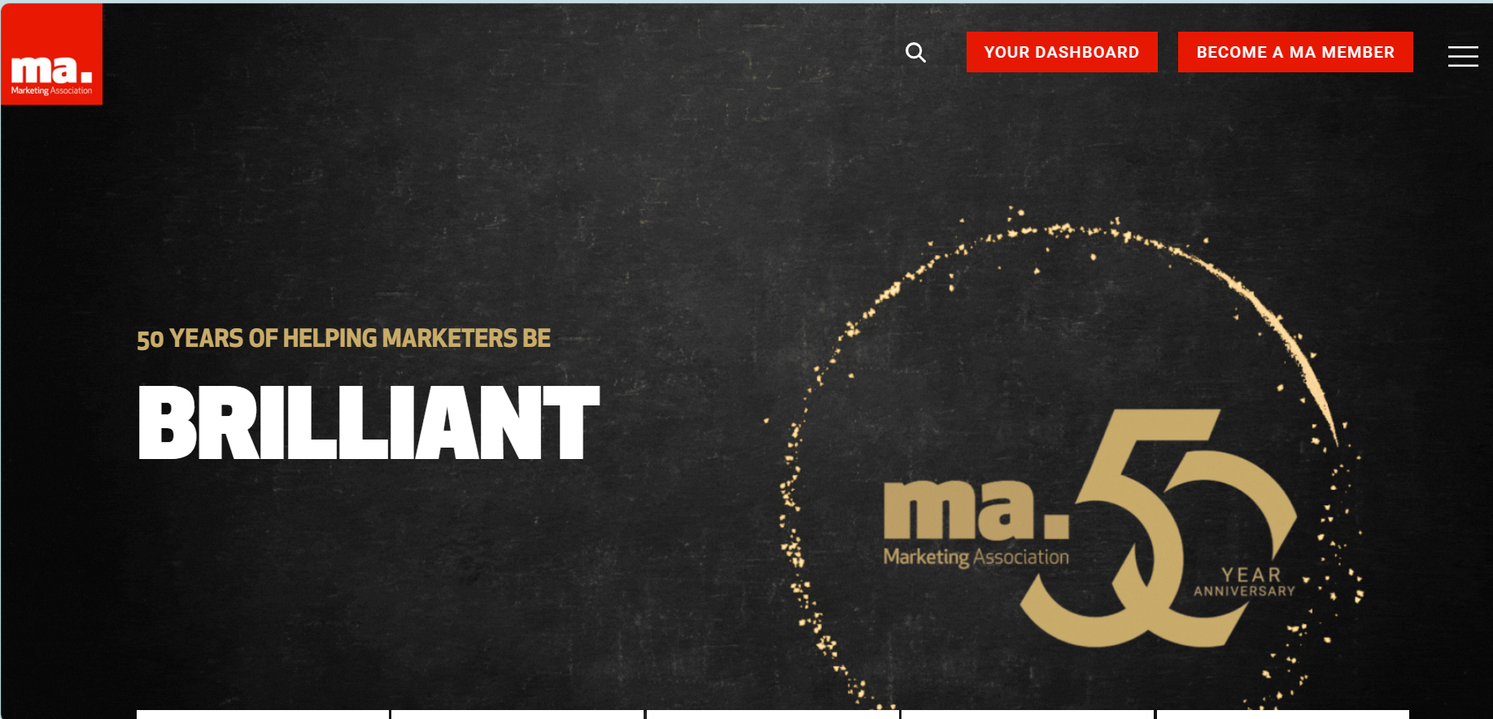


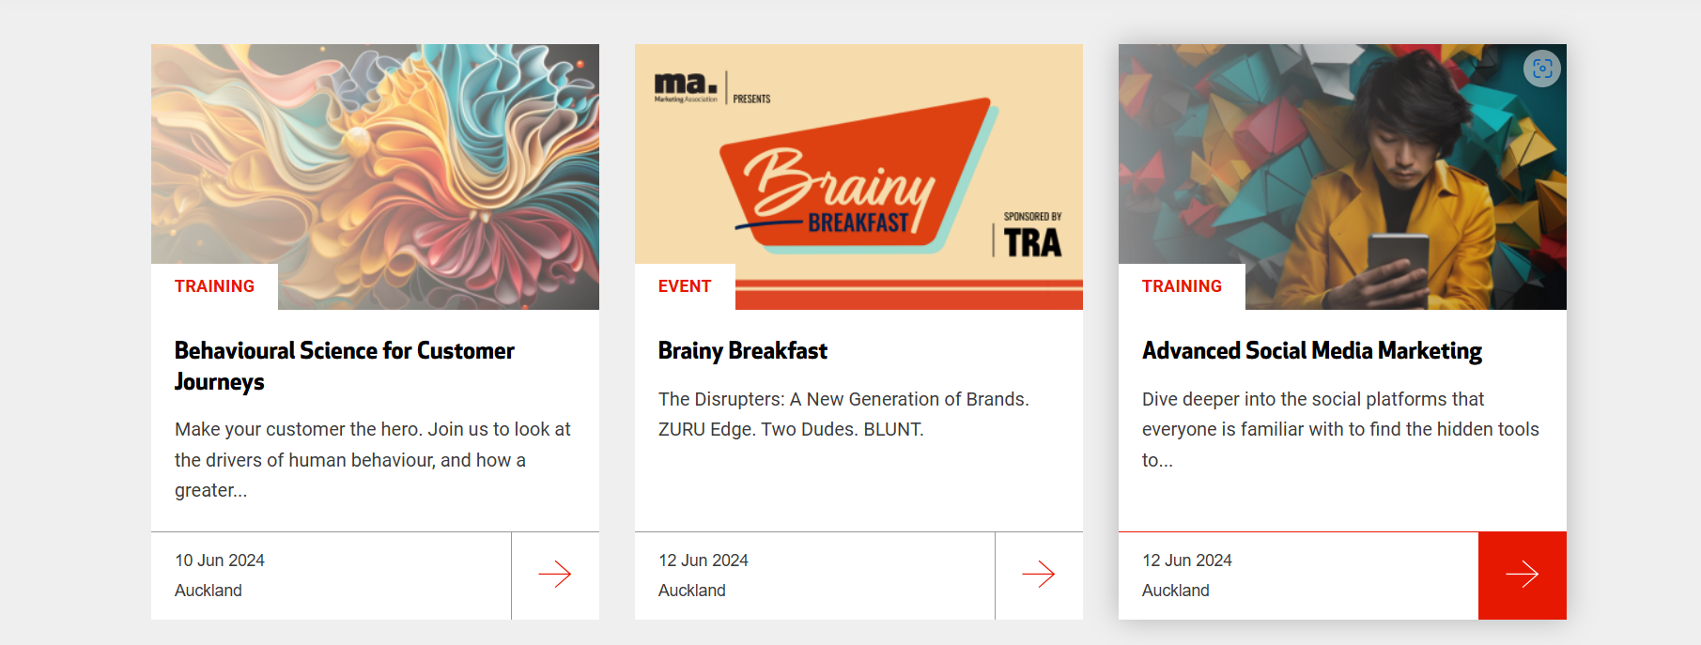
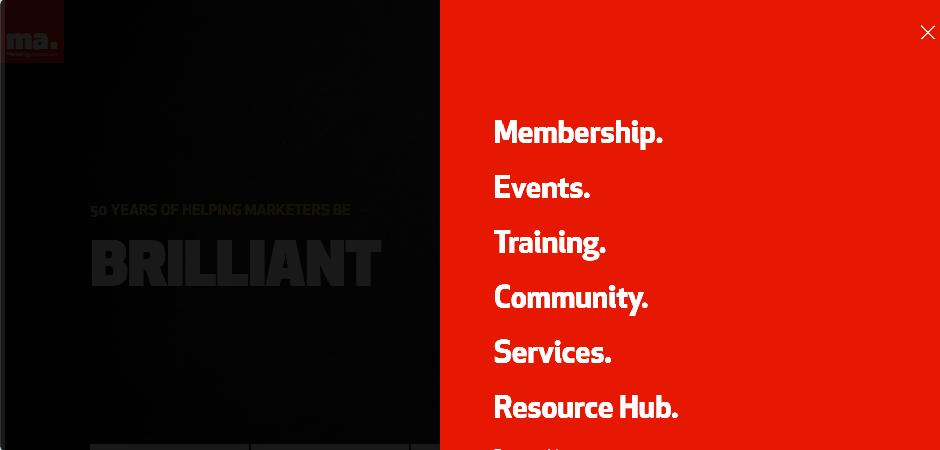
Mood Board: “Elevating NZ’s Marketing Landscape”

Slide 6
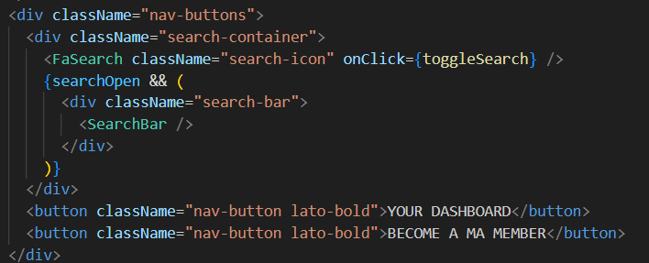
Components Developed
Header
This snippet showcases the search functionality and navigation buttons within the header. The FaSearch icon toggles the visibility of the SearchBar component, enhancing user interaction and accessibility.

Slide 7
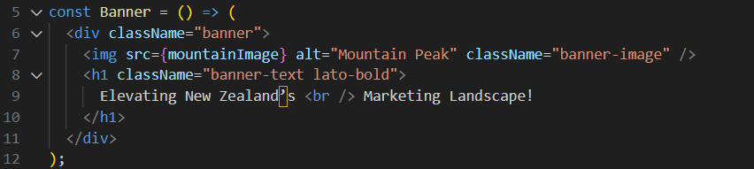
Components Developed
Banner
The banner component features a prominent image with a headline. The use of JSX allows for clear structuring of HTML elements within a React component. The image and text are styled to create a visually appealing and informative banner.

Slide 8
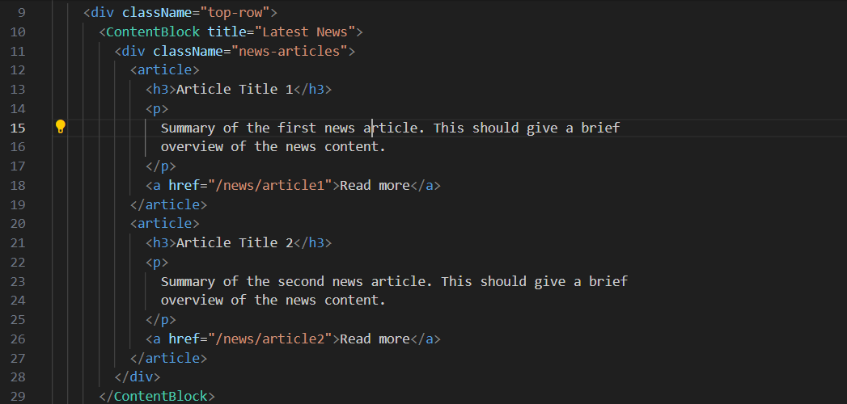
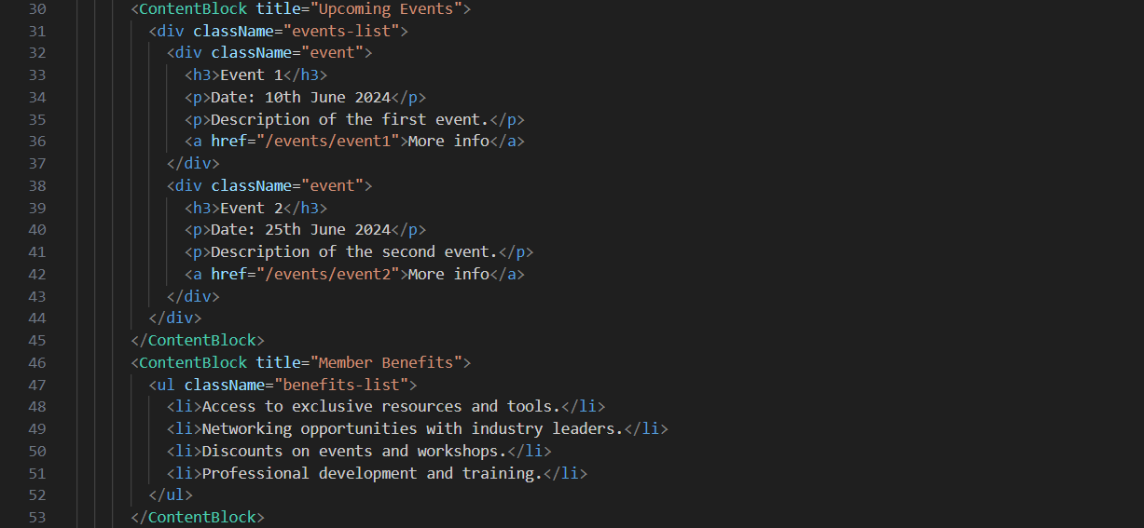
Components Developed
Main Content
The snippet highlights the structure of the Latest News, Upcoming events and Member benefits section within the main content area, using the ‘ContentBlock’ component allows for modular and reusable content sections.

Slide 9
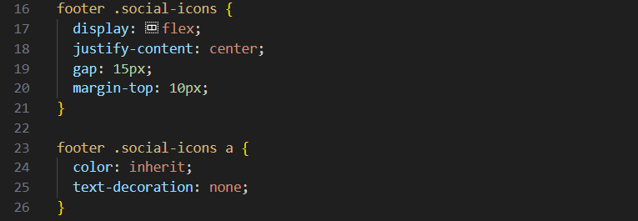
Components Developed
Footer
The footer contains social media links styled with CSS. The ‘display: flex’ property ensures the icons are aligned horzontall, and ‘gap’ provides spacing between them.

Slide 10
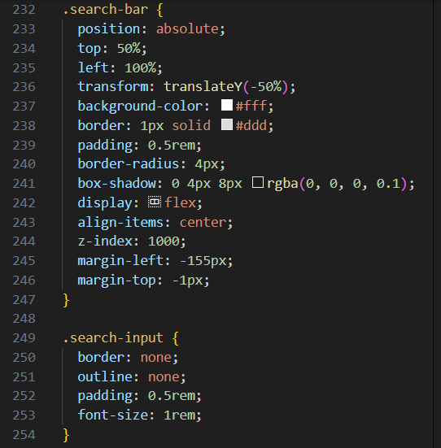
Components Developed
Search Bar
The search bar is styled to appear as a pop-up when activated. The position: absolute and transform properties ensure it is correctly aligned next to the search icon, while the box shadow adds a subtle depth effect, enhancing its visibility and aesthetics.

Slide 11
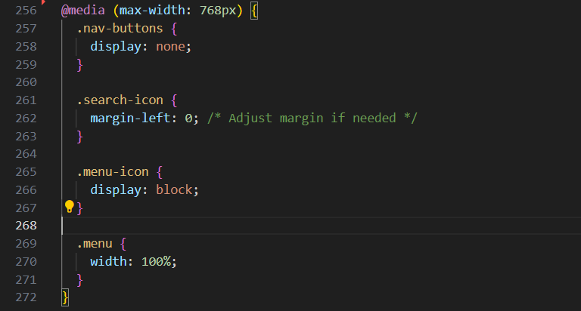
Responsive design
Media queries are used to adjust the layout for smaller screens. This snippet hides the navigation buttons on small screens, adjusts the search icon's margin, and ensures the menu covers the full screen, maintaining usability and visual appeal on mobile devices.

Slide 12

Thank you

